Slide 1
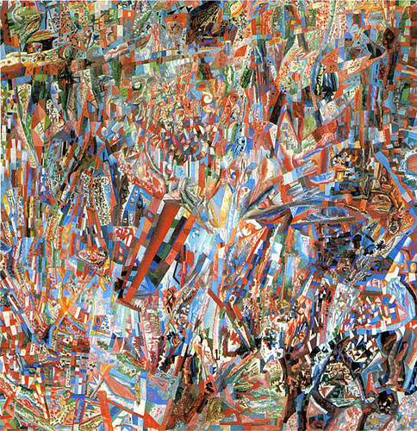
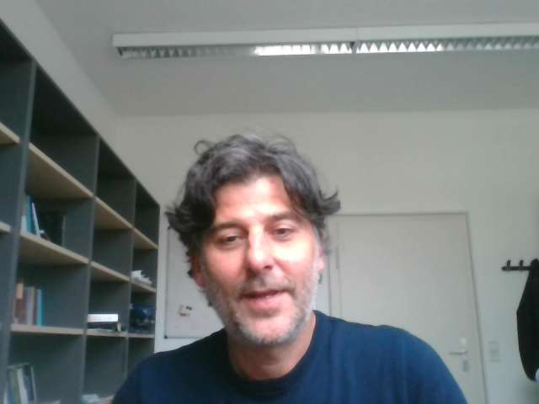
Superdiversity and the Imaginary of Society
Boris Nieswand, University of Tübingen

Slide 2

Superdiversity (Steven Vertovec)
‘Diversification of Diversity’
Migration is part of globalization processes → higher degree of social complexity
Global Trend of migratory patterns:
  1950s-70s few sending countries, few receiving areas
  1980s-today many sending countries, many receiving countries
Multidimensional Complexification,
    …. Country of Origin, Education, Language, Wealth, Purpose of Migration, Duration of Stay, Religion, legal Status, Religion or subreligious division, generation, transnationaliy…

Slide 3
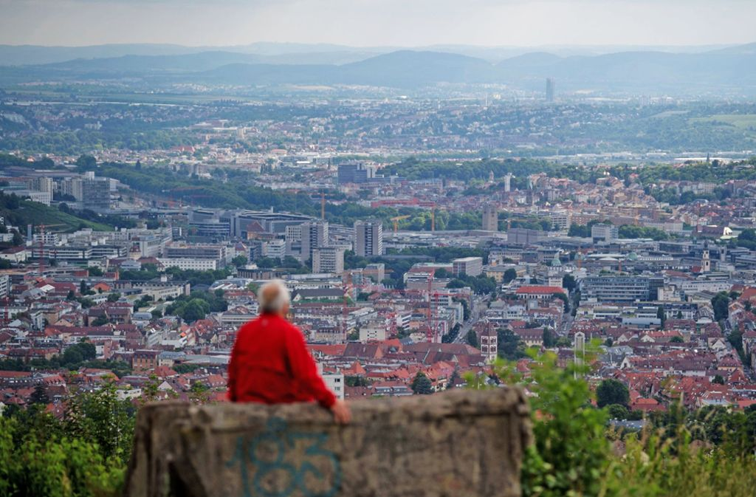
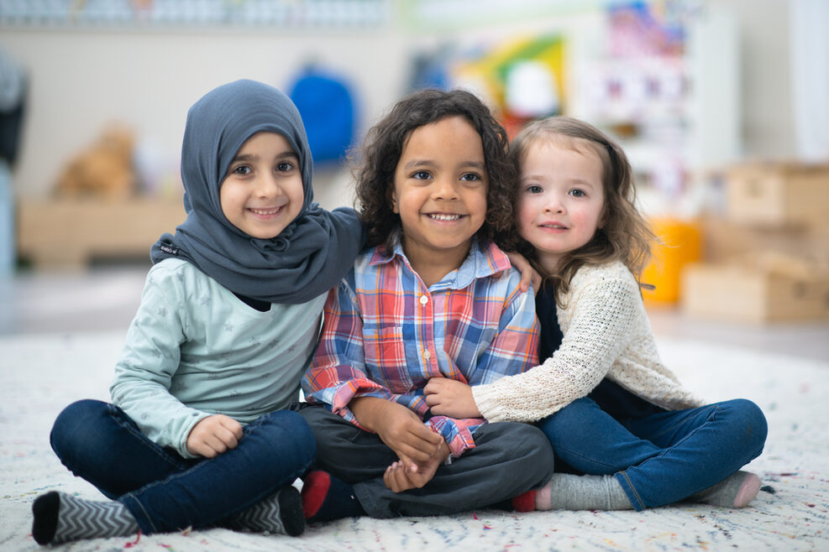
Diversity in Stuttgart
Stuttgart (1978), n = 95.413
Country | Number | Per Cent
Greece | 14.929 | 15,6
Turkey | 12.930 | 13,5
Italy | 17.519 | 18,3
Yugoslavia | 27.923 | 29,3
Spain | 3.512 | 3,7
Gesamt | 76.804 | 80,5
      173 Nationalities
        Europe 77 %
        Asia 11,5%,
        Africa 3,3 %
        America 2,8%
Stuttgart (2016) n = 153.500
Country | Number | Per Cent
Greece | 13.939 | 9,0
Turkey | 18.446 | 12,0
Italy | 13.647 | 9,0
Ex-Yugoslavia | 26.364 | 17,2
Spain | 3072 | 2,1
Gesamt | 78.560 | 56,2
      Foreigners in Stuttgart
      1955: 10.112 1.6%
      1978 95.413 16.5 %
      2016: 153.500 25.2%
      Migration Background : 268.746, approx. 45 %
      Number of Persons form the „recuitment countries“ remains constant
Migration becomes more globally

Slide 4
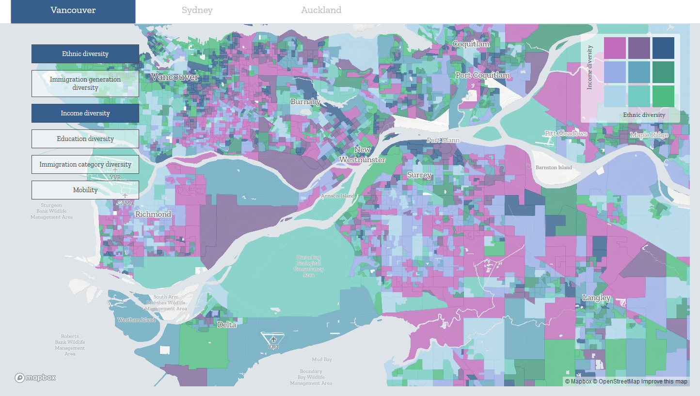
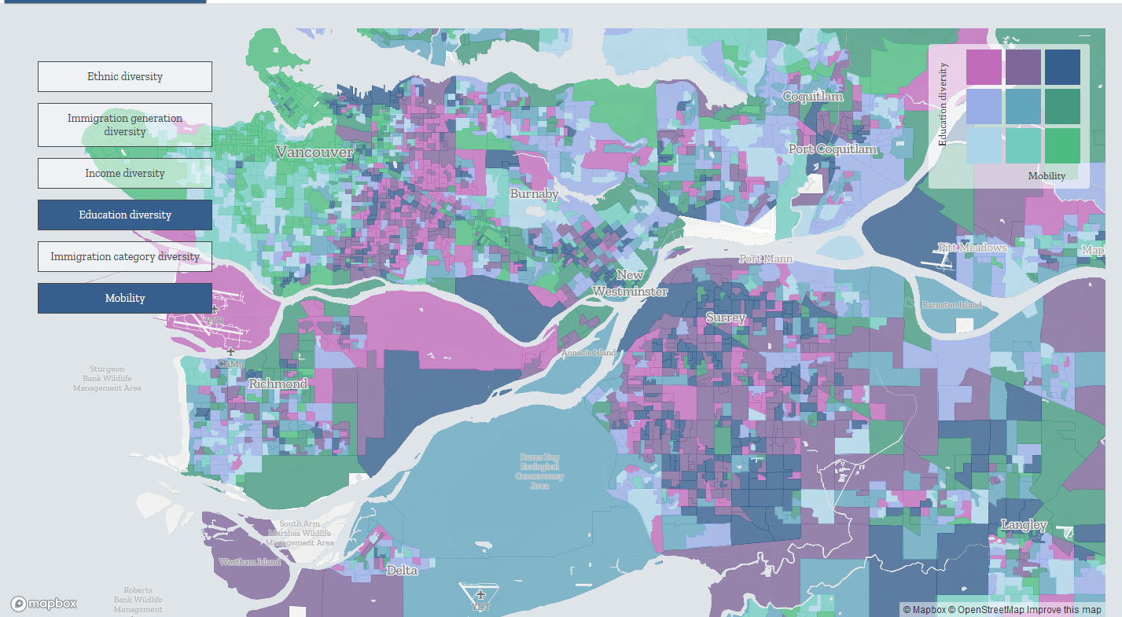
Vancouver
Ethnic Diversity <> Income Diversity
Education Diversity <> Mobility
https://superdiv.mmg.mpg.de

Slide 5
The Social Construction of Diversity
Diversity → Categorization Processes
‚Categories that matter‘de pend on the perspective, they change historically, situationally locally.
Proliferation of person-related differences
  Psychological & Medical Differences, Political Orientation, Hobbies, Life-Style, Ethnic Categorization, Sexual Orientation, Gender
Diversity Discourse has two ends: Demographic Change and Sociologiy of Classification

Slide 6
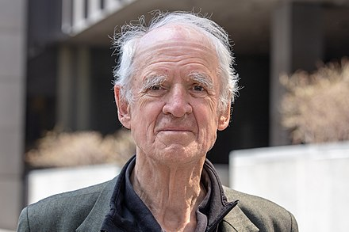
Social Imaginary
What I’m trying to get at with this term is something much broader and deeper than the intellectual schemes people may entertain when they think about social reality in a disengaged mode . . . I speak of imaginary because I’m talking about the way ordinary people “imagine” their social surroundings, and this is often not expressed in theoretical terms; it is carried in images, stories, and legends. (Taylor 2002: 106)

Slide 7
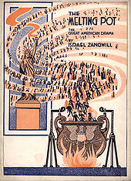
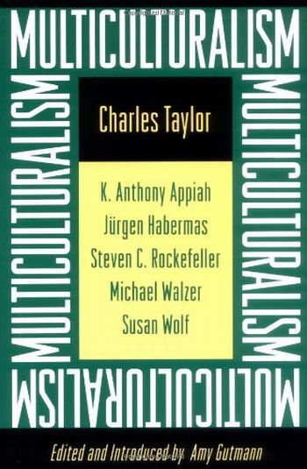
Social Imaginaries
The Melting Pot
Ethnic Assimilationism
Ethnic Pluralism/Multiculturalism
Diversity
  - Intersecting and cross-cutting differences
  Everybody is part of the confguration of diversity
  Blurrs boundaries between Majority &Minority
  Diversity - if managed well - is a good thing
Diversity became a dominant Imaginary
Political Division between those who are for and against diversity

Slide 8
How can (super)diverse societies create cohesion?
Classical Communitarianism (e.g. Putnam 2007)
Instutionalism (Portes & Vickstrom 2011)
Conviviality (Amin 2002; Gilroy 2004; Nowicka & Vertobec 2014)

Slide 9
Questions for Discussion
Superdiversity
- Demographic Changes
Categorization Processes
Social Imaginary
Social Cohesion
Has your enviroment experienced diversification in the last decades?
In how far does (Super)diversity Matter for your life?
(3) What challenges do you see for your environement? For Society?
(4) In how far diversity can be a resource for the future of society?

Slide 10
References
Amin, Ash. 2002. "Ethnicity and the Multicultural City: Living with Diversity." Environment & Planning A 34:959-980.
Bouma, Gary, Dharma Arunachalam, Alan Gamlen and Ernest Healy. 2021. "Religious Diversity through a Super-Diversity Lens: National, Sub-Regional and Socio-Economic Religious Diversities in Melbourne." Journal of Sociology:14407833211011256.
Crul, Maurice. 2016. "Super-Diversity Vs. Assimilation: How Complex Diversity in Majority–Minority Cities Challenges the Assumptions of Assimilation." Journal of Ethnic and Migration Studies 42 (1):54-68. doi: 10.1080/1369183X.2015.1061425.
Eriksen, Thomas Hylland. 2006. "Diversity Versus Difference: Neo-Liberalism in the Minority Debate." In The Making and Unmaking of Differences. Anthropological, Sociological and Philosophical Perspectives, edited by Richard Rottenburg, Burkhard Schnepel and Shingo Shimada, 13-25. Bielefeld: Transcript Verlag.
Gilroy, Paul. 2004. After Empire: Melancholia or Convivial Culture? London: Routledge.
Nieswand, Boris. 2020. "Is Diversity a Useful Theoretical Concept?" In Diversities. Theories and Practices, edited by Jan Hinrichsen, Jan Lange and Raphael Reichel, 29-46. Tübingen: Tübinger Vereinigung für Volkskunde.
Nieswand, Boris. 2021. "Die Diversität Der Diversitätsdikussion,." In Handbuch Migrationssoziologie edited by Antje Röder and Darius Zifonun. Wiesbaden: Springer.
Nowicka, Magdalena and Steven Vertovec. 2014. "Comparing Convivialities: Dreams and Realities of Living-with-Difference." European Journal of Cultural Studies 17 (4):341 –356.

Slide 11
Portes, Alejandro and Erik Vickstrom. 2011. "Diversity, Social Capital, and Cohesion." Annual Review of Sociology 37 (1):461-479.
Putnam, Robert D. 2007. "E Pluribus Unum: Diversity and Community in the Twenty-First Century the 2006 Johan Skytte Prize Lecture." Scandinavian Political Studies 30 (2):137-174. doi: 10.1111/j.1467-9477.2007.00176.x.
Scholten, Peter, Maurice Crul and Paul van de Laar, eds. 2019. Coming to Terms with Superdiversity. Cham: Springer Imprint.
Taylor, Charles. 2002. "Modern Social Imaginaries." Public Culture 14 (1):91-124.
Vertovec, Steven. 2007. "Super-Diversity and Its Implications." Ethnic and Racial Studies 30 (6):1024-54
Vertovec, Steven. 2012. "“Diversity” and the Social Imaginary." European Journal of Sociology / Archives Européennes de Sociologie 53 (03):287-312
Vertovec, Steven. 2021. "The Social Organization of Difference." Ethnic and Racial Studies:1-23. doi: 10.1080/01419870.2021.1884733.

